Slide 1

Uber – mini project
Harish Rewatkar
© All rights reserved by Fireblaze Technologies Pvt. Ltd.

Slide 2
Problem Statement
- The aim of analysis is to identify the root cause of the problem (i.e. cancellation and non-availability of cars) and recommend ways to improve the situation.
© All rights reserved by Fireblaze Technologies Pvt. Ltd.

Slide 3
Proposed Solution
Assigning few extra cabs specially to the airport trips.
Provide incentives for airport trips during peak time.
© All rights reserved by Fireblaze Technologies Pvt. Ltd.

Slide 4
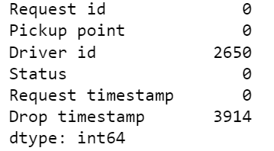
Data Visualization Analysis
- Driver id & Drop timestamp have more null values.
© All rights reserved by Fireblaze Technologies Pvt. Ltd.

Slide 5
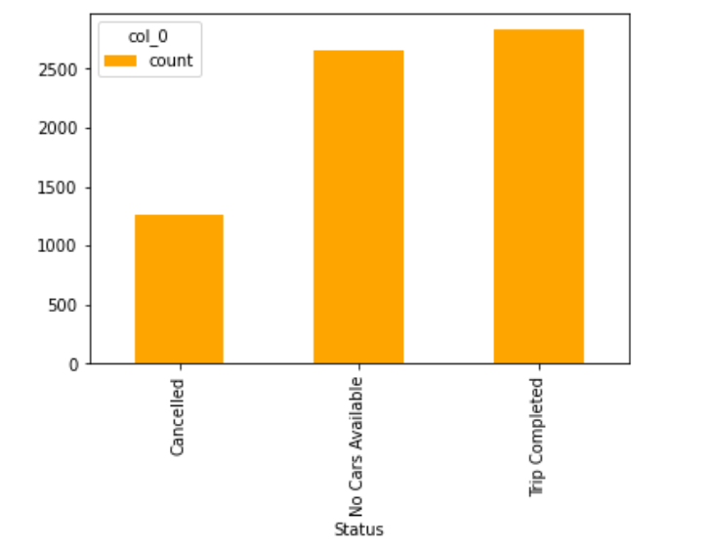
- No cars available is near about the same with the trip completed.

Slide 6
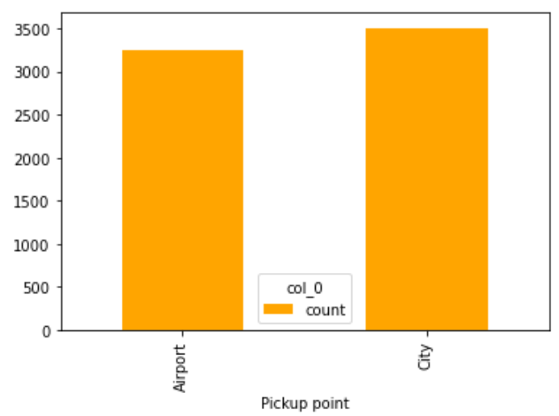
- From Airport & City got the similar amount of request for the trip.

Slide 7
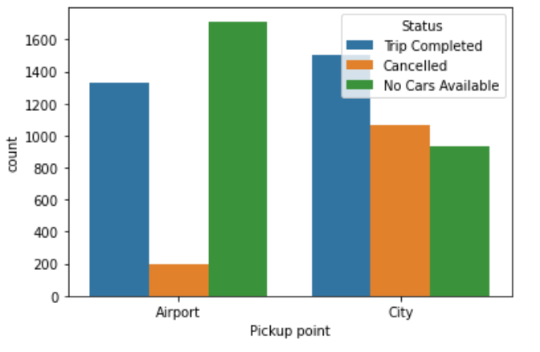
At the time of trip request from Airport, There wasnot available cars for trip.
In the City, trips cancelled is very much high.

Slide 8
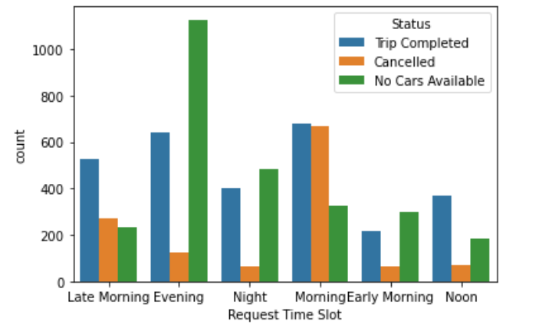
Evening, night & morning time amount of no cars available is very much.
Morning time trips are similar amount trip cancelled w.r.to trip completed.

Slide 9
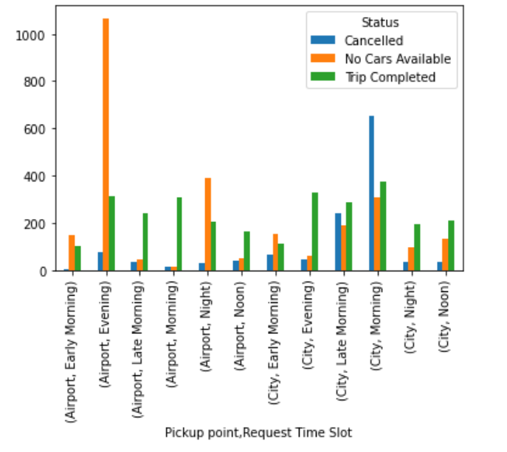
Morning, Evening, Night trips comes from airport No car available at that time.
Morning time trips comes from city cancelled & No car available

Slide 10
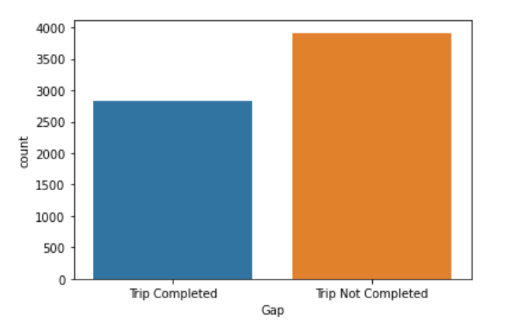
Gap between Trip completed & Trip not completed

Slide 11
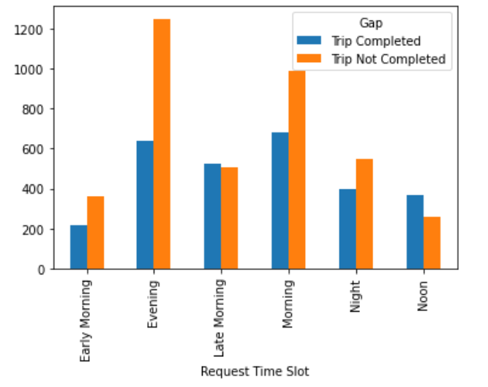
Early morning, Evening, Morning, Night at that time trip not completed are more.

Slide 12
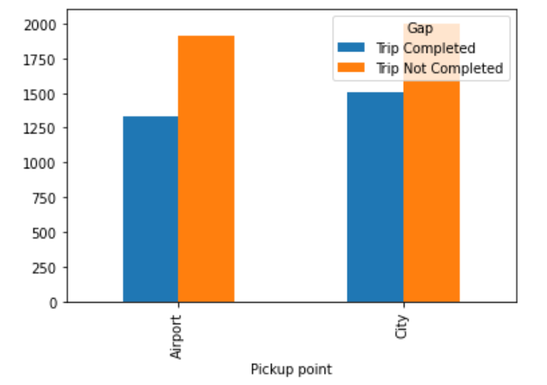
Trip not completed are more which comes from Airport & City

Slide 13
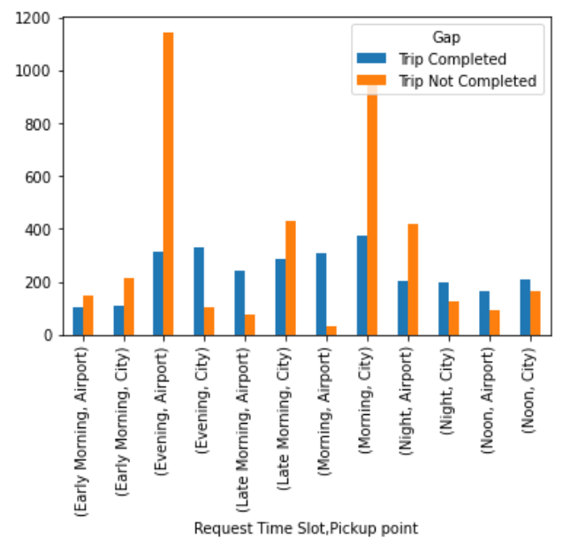
Airport – Early Morning, Evening, Night more trips not completed.
City – Early Morning, Late Morning, Morning more trips not completed.

Slide 14
Advantage
We get the root cause of the problem like we get information about there are no cars present on airport everytime for customers.
We get information about the so many drivers/customers cancelling the request for the trip in the cities.
© All rights reserved by Fireblaze Technologies Pvt. Ltd.

Slide 15
Disadvantage
Maybe different problems are present for this type of result like competitor, airport location/parking problems.
© All rights reserved by Fireblaze Technologies Pvt. Ltd.

Slide 16
Conclusion
Increase the no. of cars from the Airport trips.
Give more incentives to drivers from Airport trips so no cars available graph will reduce.
If the Driver accept & then cancel the trip then driver should pay fine for that.
© All rights reserved by Fireblaze Technologies Pvt. Ltd.

Slide 17
Future Scope
More cars will present at the airport so customer will get service easily & fast.
If the driver willnot cancel the request then customer will go anywhere fast then that service will use again so company can increase their profits.
© All rights reserved by Fireblaze Technologies Pvt. Ltd.

